Slide 1


Project analysis slide 3
A Project Phase - 2 Presentation On
Design and analysis of a Slotted Vivaldi Antenna for Microwave Imaging Applications
By
HARSHA S 1GV20EC011
NAVEEN KUMAR N 1GV20EC024
SHASHANK C 1GV20EC032
Date: 29/05/2024
Carried out at
Dr.T.Thimmaiah Institute of Technology
Under the guidance of,
Dr. Vijaya Geetha R
Associate Professor
Department of ECE
Dr.TTIT, KGF

Slide 2


Project analysis slide 2
Design and analysis of a Slotted Vivaldi Antenna for Microwave Imaging Applications
2023-2024
CONTENTS
ABSTRACT
OBJECTIVES
INTRODUCTION
METHODOLOGY
PROJECT
REASON FOR SELECTING
THE PROJECT
IMPLEMENTATION
LITERATURE SURVEY
RESULTS
PROBLEM STATEMENT
CONCLUSION

Slide 3
Project analysis slide 3
Design and analysis of a Slotted Vivaldi Antenna for Microwave Imaging Applications
2023-2024
ABSTRACT
An microstrip line feed ultra-wideband (UWB) slotted Vivaldi antenna, designed on an FR4 substrate with dimensions of 50×50×1.5 mm³.
Design details involve a microstrip line feed with radial stubs, tapered slots, and resonant cavities to cover a wide frequency range. It is anticipated that the antenna will operate in the ultrawide band of 12GHz.
With its wide bandwidth and optimal radiation characteristics, the antenna is versatile and well-suited for various applications in microwave imaging.
The antenna's behavior is meticulously examined through time domain simulation using CST Microwave Studio.

Slide 4
Project analysis slide 3
Design and analysis of a Slotted Vivaldi Antenna for Microwave Imaging Applications
2023-2024
INTRODUCTION
An advanced ultra-wideband (UWB) slotted Vivaldi antenna specifically designed for microwave imaging (MI) purposes.
The compact Vivaldi antenna shows great promise for microwave imaging applications due to its small size and potential for outstanding performance.
The design evolution is presented in four stages, basic Vivaldi antenna, Vivaldi Antenna with Resonant Cavities, Slotted Vivaldi Antenna and The final design.
Vivaldi Antennas play a crucial role in various microwave imaging applications, contributing to the progression of fields such as medical imaging, security screening, and remote sensing.

Slide 5
Project analysis slide 3
Design and analysis of a Slotted Vivaldi Antenna for Microwave Imaging Applications
2023-2024
Reason for Selecting this Project
The design involves sophisticated elements such as radial stubs, tapered slots, and resonant cavities. This complexity provides an opportunity to engage in innovative design techniques and explore advanced concepts in microwave engineering.
This antenna is great for UWB microwave imaging because it's compact, has a wide bandwidth, and produces strong radiation. It improves performance in various imaging situations.
Microwave imaging is super important and growing, used in medical imaging, security screening, and industrial inspections.

Slide 6
Project analysis slide 8
Design and analysis of a Slotted Vivaldi Antenna for Microwave Imaging Applications
2023-2024
Literature Survey
YEAR
AUTHOR
TITLE
DESCRIPTION
Designing Vivaldi Antenna with Various Sizes
using CST Software
The study investigates how these variations influence parameters like VSWR and S11 across the 2 to 18 GHz frequency range.
2011
Norhayati Hamzah, Kama Azura Othman
Performance of Directional and Omnidirectional
Antennas in Wideband Head Imaging
The designed antennas cover a wide bandwidth of 1.25-2.4 GHz, aligning with the typical frequency range used in microwave head imaging applications.
Ahmed Toaha Mobashsher, A.M. Abbosh
2016
Md Masud Rana, Reshma Khanom and Md Mostafizur Rahman
Design and Analysis of Vivaldi Antennas
The focus on the application of Vivaldi antennas in biomedical scenarios
2018
Nurul S. Hasim, Kismet A. H. Ping, Mohammad T. Islam
A Slotted UWB Antipodal Vivaldi Antenna
for Microwave Imaging Applications
The introduction of a slotted design for the ultra-wideband (UWB) antipodal Vivaldi antenna (APVA)
2019

Slide 7
Project analysis slide 8
Design and analysis of a Slotted Vivaldi Antenna for Microwave Imaging Applications
2023-2024
Literature Survey
YEAR
AUTHOR
TITLE
DESCRIPTION
Liton Chandra Paul, Md. Nur Hossain, Md. Mamun Ur Rashid
Tapered Slot Ultra Wide Band Vivaldi Antenna
For Microwave Imaging Applications
This design approach aims to achieve improved performance and miniaturization of the antenna.
2019
Eng. Reem Alageea, Dr. Abdulkarim Assalemb
The significant enhancement achieved in the performance of the VIVALDI antenna through the incorporation of a U-shaped slot on the upper layer
U-Shaped Slot VIVALDI
Antenna and Confocal Radar Based Microwave Imaging
2020
A Unique Technique to Improve the Performance
of Antipodal Vivaldi Antenna for Microwave
Imaging Application
A Balaji, J Karthi, V Chinnammal, C Malarvizhi
The resulting antenna design operates in a frequency range from 1.45 GHz to 9.8 GHz.
2021
Design and Analysis of a UWB Slotted Vivaldi Antenna for
Microwave Imaging Applications
The use of a microstrip line feed with specific design features such as radial stubs, tapered slots, and resonant cavities contributed to the antenna's performance.
2023
Akash Majumder,
Tithi Rani

Slide 8
Project analysis slide 3
Design and analysis of a Slotted Vivaldi Antenna for Microwave Imaging Applications
2023-2024
Problem Statement
In the existing papers, it has been found that microwave imaging Vivaldi antennas are limited by their narrow bandwidth and low gain, which struggles to detect objects and capture fine details, resulting in blurry images.

Slide 9
Project analysis slide 3
Design and analysis of a Slotted Vivaldi Antenna for Microwave Imaging Applications
2023-2024
Objectives
Develop and optimize a Vivaldi antennas to achieve a broader bandwidth.
Enhance the gain of Slotted Vivaldi antennas for improved signal strength and directionality

Slide 10
Project analysis slide 3
Design and analysis of a Slotted Vivaldi Antenna for Microwave Imaging Applications
2023-2024
METHODOLOGY
Installing CST Software
Calculation of Design Parameter
Design of Slotted Vivaldi Antenna
Simulation

Slide 11
Design and analysis of a Slotted Vivaldi Antenna for Microwave Imaging Applications
2023-2024
FLOW CHART
START
Implement Design of antenna
Optimum Result ?
Requirements and Constraints
Incorporate Radial Stub, Tapered Slots, and Resonant Cavities
NO
YES
Outline Antenna Design
Calculations
Conclusion
Simulate Antenna Performance
Choose Substrate Material
(e.g., FR4)
Analyze Radiation Characteristics, Bandwidth, and Efficiency
STOP

Slide 12
Design and analysis of a Slotted Vivaldi Antenna for Microwave Imaging Applications
2023-2024
CST STUDIO SUITE
CST Studio Suite is a powerful electromagnetic (EM) simulation software package developed by Dassault Systems. It is used to design, analyze, and optimize a wide variety of EM components and systems, including antennas, filters, cables, connectors, and microwave devices. The software is based on the Finite Integral Method (FIM), a numerical technique that can be used to solve a wide range of electromagnetic problems.
CST Studio Suite is used to design a wide variety of antennas.
CST Studio Suite is used to design filters.
CST Studio Suite is used to design a wide variety of microwave devices,

Slide 13
Design and analysis of a Slotted Vivaldi Antenna for Microwave Imaging Applications
2023-2024
Substrate Material Used
FR-4 is a type of glass-reinforced epoxy laminate that is commonly used as a substrate material for printed circuit boards (PCBs). It is also popular choice for antenna design.
The dielectric constant of FR-4 is around 4.4
The loss tangent of FR-4 is around 0.02
FR-4 is a relatively inexpensive material
Easy to fabricate

Slide 14
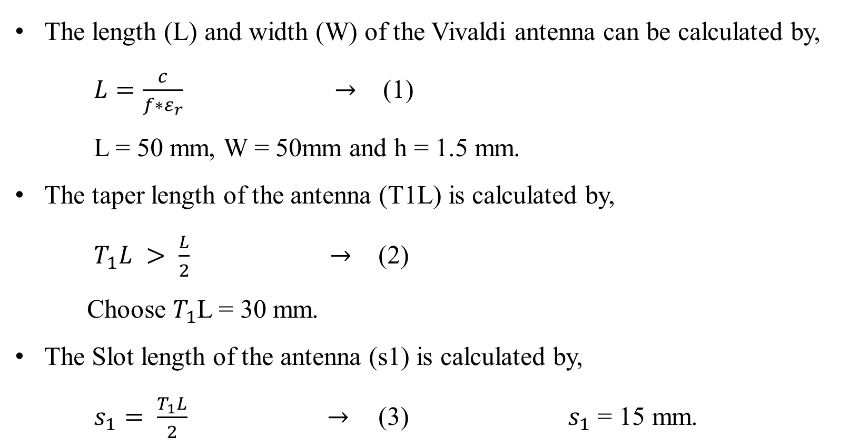
Design and analysis of a Slotted Vivaldi Antenna for Microwave Imaging Applications
2023-2024
DESIGN CALCULATIONS
The length (L) and width (W) of the Vivaldi antenna can be calculated by,
$L=\frac{c}{f∗ε_{r}} →$ (1)
L = 50 mm, W = 50mm and h = 1.5 mm.
The taper length of the antenna (T1L) is calculated by,
$T_{1}L > \frac{L}{2} →$ (2)
Choose $T_{1}$L = 30 mm.
The Slot length of the antenna (s1) is calculated by,
$s_{1}= \frac{T_{1}L}{2} →$(3) $s_{1}$ = 15 mm.

Slide 15
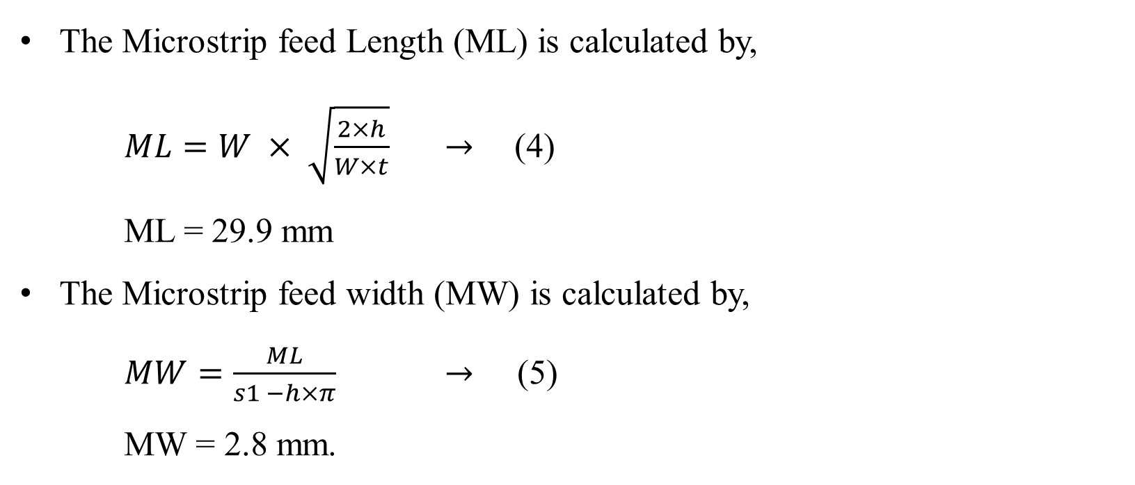
Design and analysis of a Slotted Vivaldi Antenna for Microwave Imaging Applications
2023-2024
DESIGN CALCULATIONS
The Microstrip feed Length (ML) is calculated by,
$ML=W × \sqrt{\frac{2×h}{W×t}} →$ (4)
ML = 29.9 mm
The Microstrip feed width (MW) is calculated by,
$MW=\frac{ML}{s1 −h×π} →$ (5)
MW = 2.8 mm.

Slide 16
Design and analysis of a Slotted Vivaldi Antenna for Microwave Imaging Applications
2023-2024
Design Parameters
PARAMETERS | Values (mm)
Length of the antenna (L) | 50
Width of the antenna (W) | 50
Height of the antenna (h) | 1.5
Thickness of the metallic layer (t) | 0.035
Taper length of the antenna (T1L) | 30
Slot length of the antenna (S1) | 15
Microstrip feed length (ML) | 29.9
Microstrip feed width (MW) | 2.8
Tapper rate (r) | 0.13
Throat width (s) | 0.4
Outer mouth opening (M1) | 39.5

Slide 17
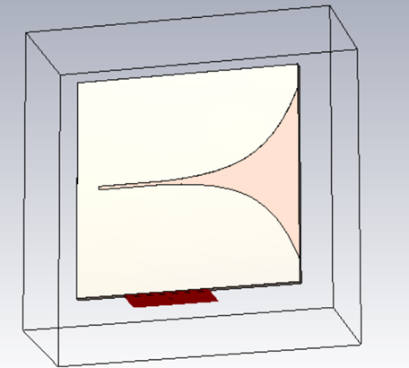
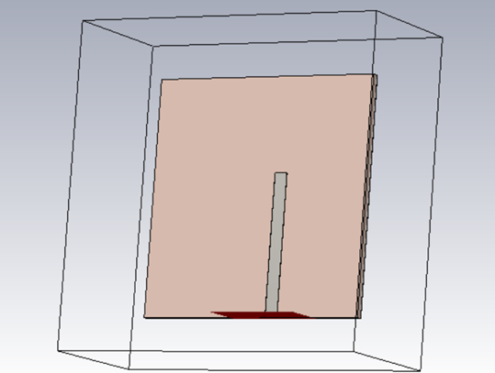
Design and analysis of a Slotted Vivaldi Antenna for Microwave Imaging Applications
2023-2024
Stage 1 : Simple Vivaldi Antenna

Slide 18
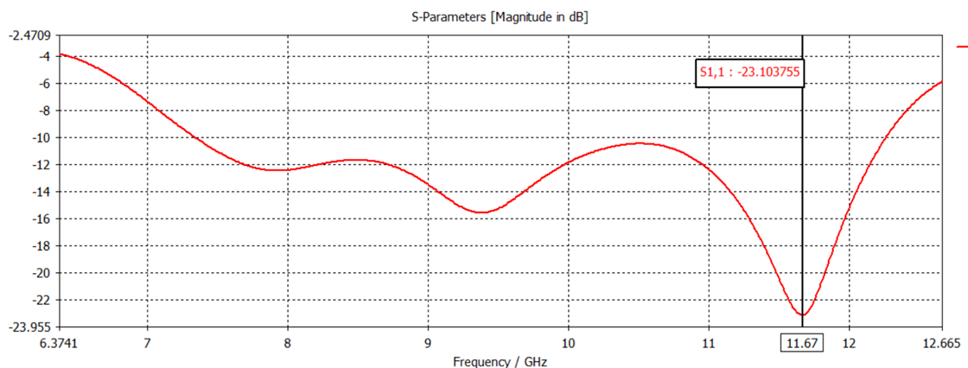
Design and analysis of a Slotted Vivaldi Antenna for Microwave Imaging Applications
2023-2024
Stage 1 : Simulation Results

Slide 19
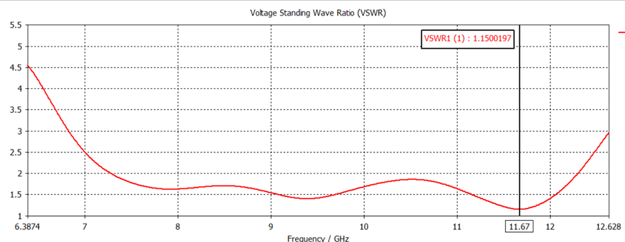
Design and analysis of a Slotted Vivaldi Antenna for Microwave Imaging Applications
2023-2024
Stage 1 : Simulation Results

Slide 20
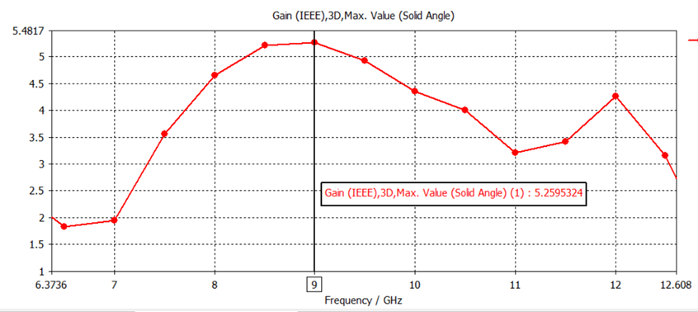
Design and analysis of a Slotted Vivaldi Antenna for Microwave Imaging Applications
2023-2024
Stage 1 : Simulation Results

Slide 21
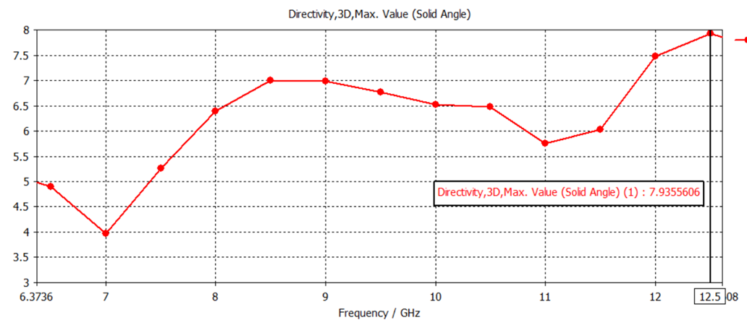
Design and analysis of a Slotted Vivaldi Antenna for Microwave Imaging Applications
2023-2024
Stage 1 : Simulation Results

Slide 22
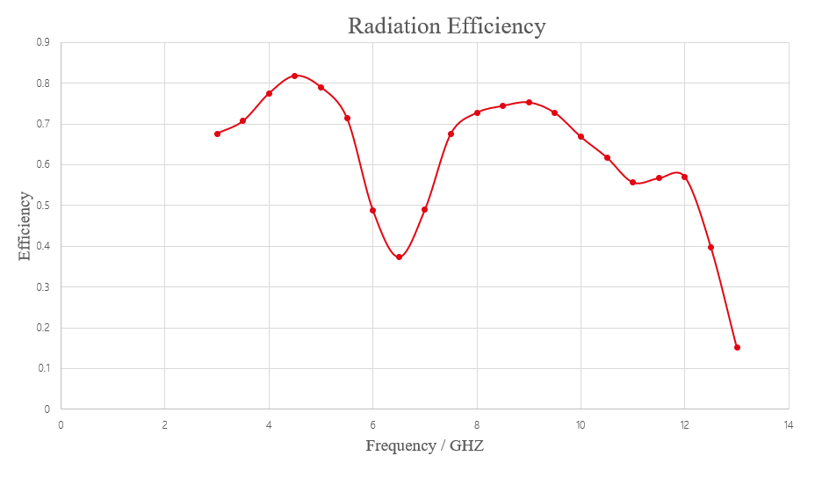
Design and analysis of a Slotted Vivaldi Antenna for Microwave Imaging Applications
2023-2024
Stage 1 : Simulation Results

Slide 23
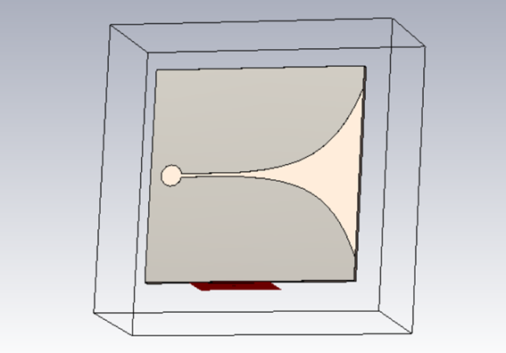

Design and analysis of a Slotted Vivaldi Antenna for Microwave Imaging Applications
2023-2024
Stage 2 : Vivaldi Antenna with Resonant Cavities

Slide 24
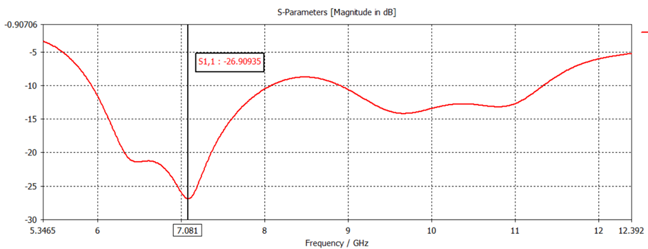
Design and analysis of a Slotted Vivaldi Antenna for Microwave Imaging Applications
2023-2024
Stage 2 : Simulation Results

Slide 25
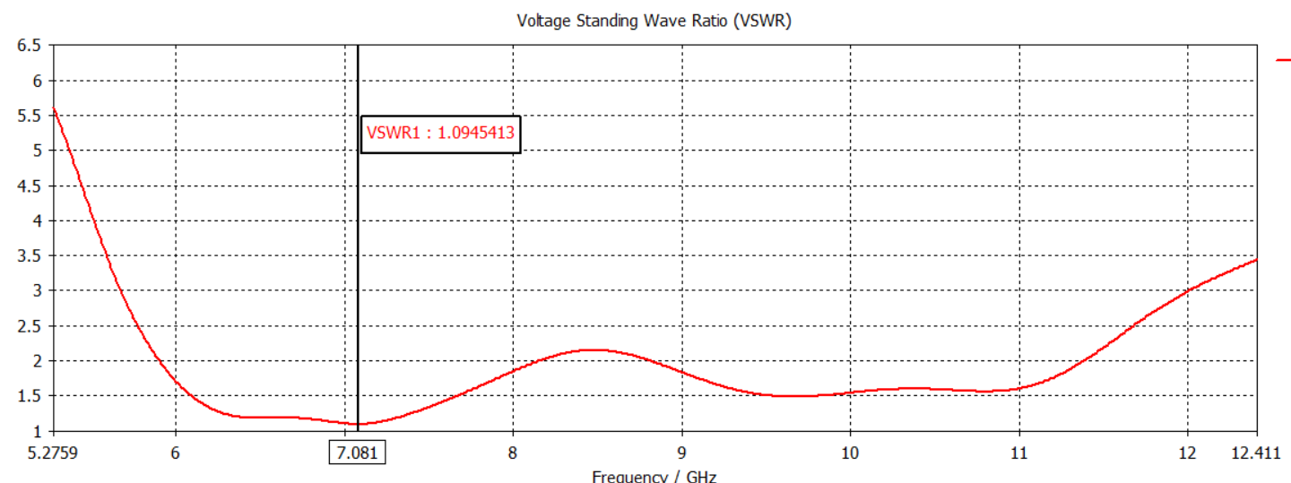
Design and analysis of a Slotted Vivaldi Antenna for Microwave Imaging Applications
2023-2024
Stage 2 : Simulation Results

Slide 26
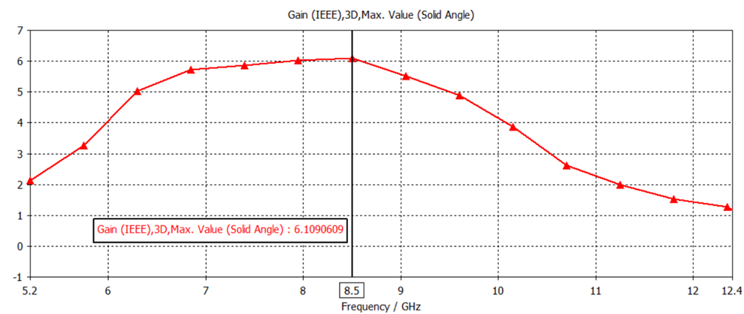
Design and analysis of a Slotted Vivaldi Antenna for Microwave Imaging Applications
2023-2024
Stage 2 : Simulation Results

Slide 27
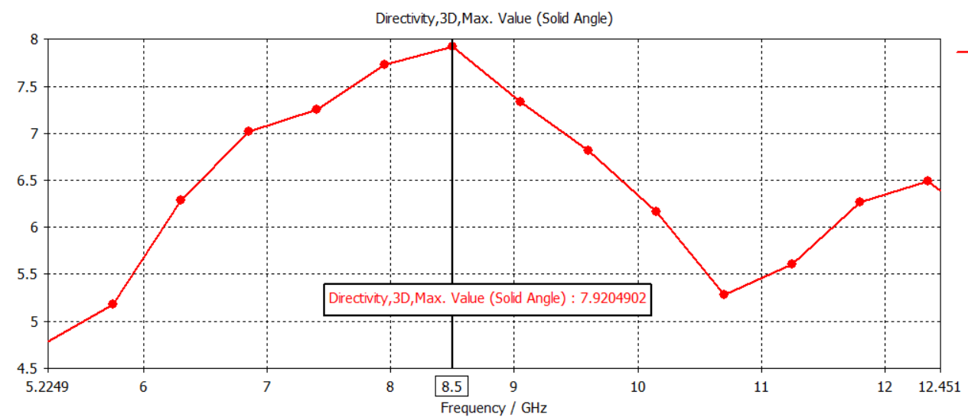
Design and analysis of a Slotted Vivaldi Antenna for Microwave Imaging Applications
2023-2024
Stage 2 : Simulation Results

Slide 28
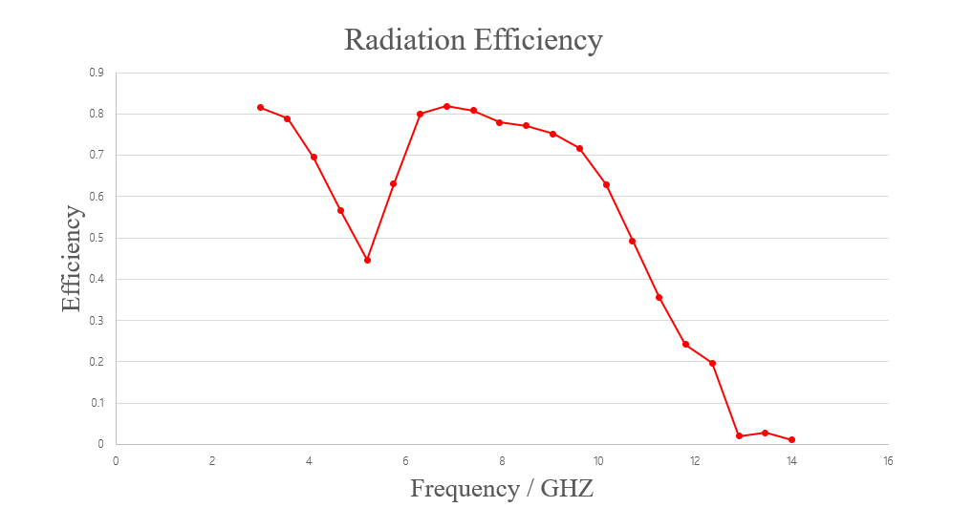
Design and analysis of a Slotted Vivaldi Antenna for Microwave Imaging Applications
2023-2024
Stage 2 : Simulation Results

Slide 29
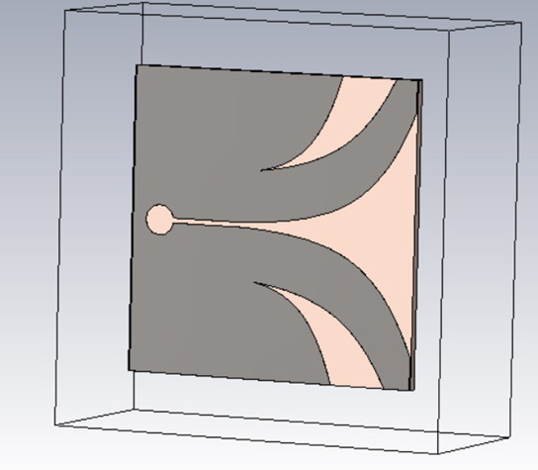
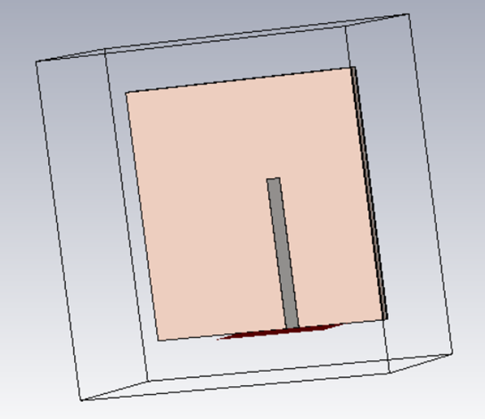
Design and analysis of a Slotted Vivaldi Antenna for Microwave Imaging Applications
2023-2024
Stage 3 : Slotted Vivaldi Antenna
8th SEM DEPT OF ECE DR TTIT, KGF

Slide 30
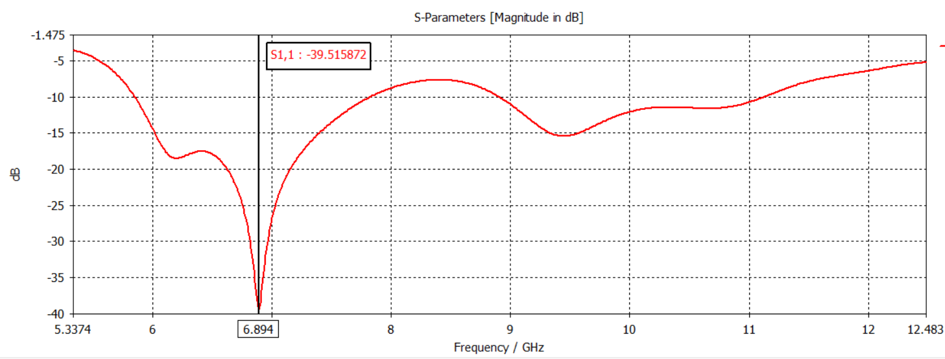
Design and analysis of a Slotted Vivaldi Antenna for Microwave Imaging Applications
2023-2024
Stage 3 : Simulation Results

Slide 31
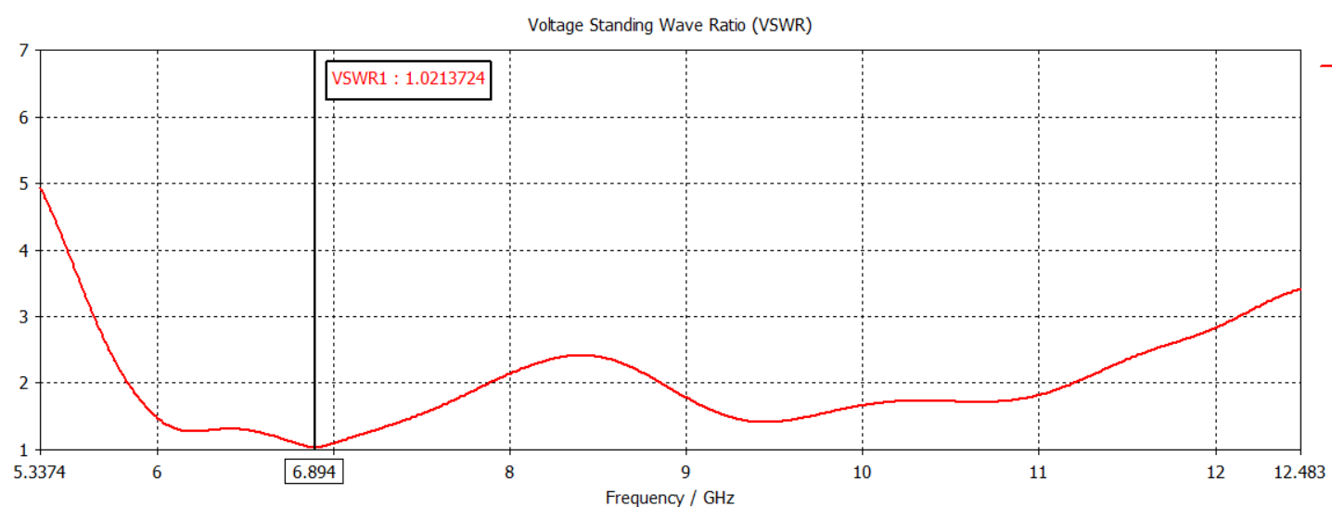
Design and analysis of a Slotted Vivaldi Antenna for Microwave Imaging Applications
2023-2024
Stage 3 : Simulation Results

Slide 32
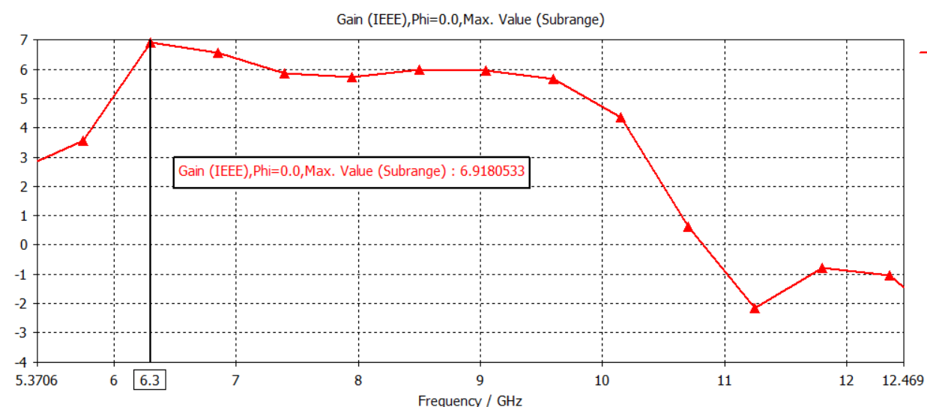
Design and analysis of a Slotted Vivaldi Antenna for Microwave Imaging Applications
2023-2024
Stage 3 : Simulation Results

Slide 33
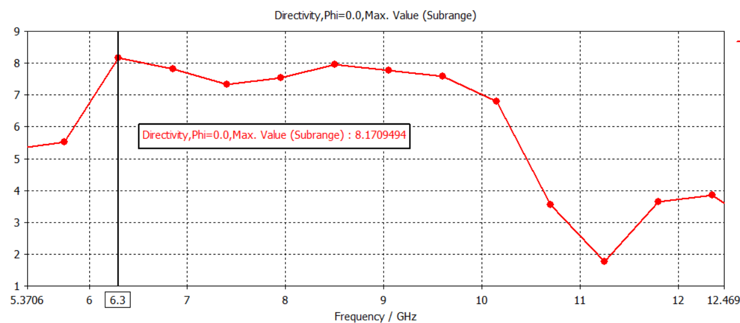
Design and analysis of a Slotted Vivaldi Antenna for Microwave Imaging Applications
2023-2024
Stage 3 : Simulation Results

Slide 34
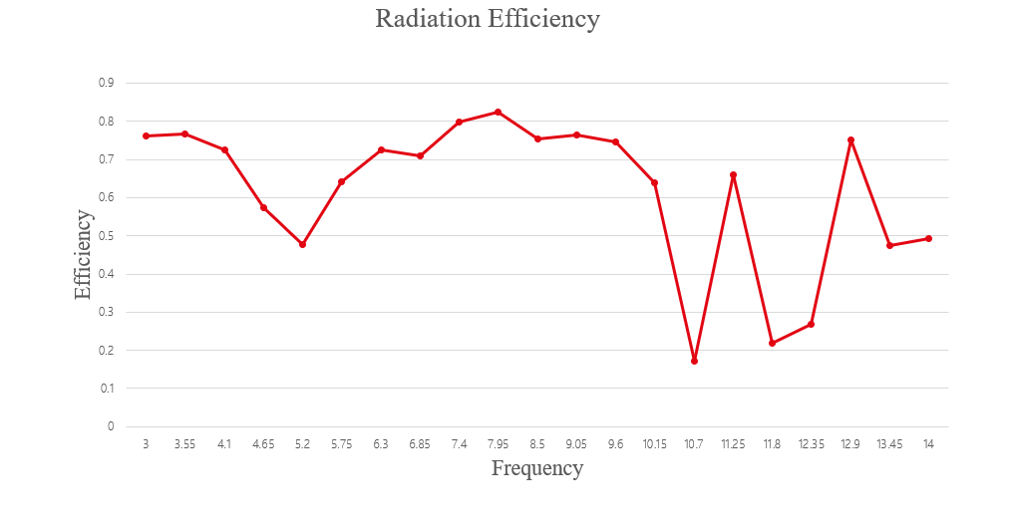
Design and analysis of a Slotted Vivaldi Antenna for Microwave Imaging Applications
2023-2024
Stage 3 : Simulation Results

Slide 35
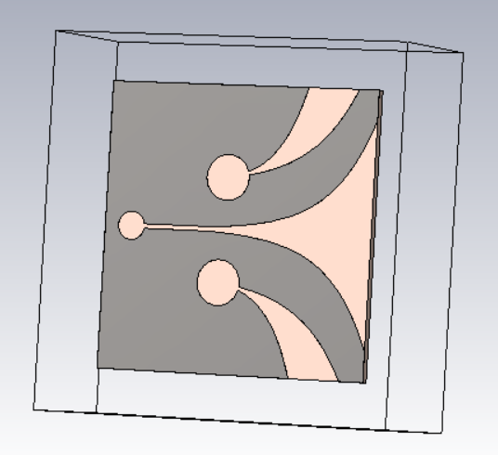
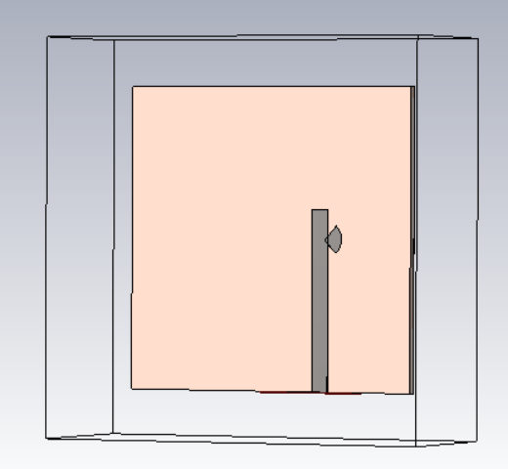
Design and analysis of a Slotted Vivaldi Antenna for Microwave Imaging Applications
2023-2024
Stage 4 : Final Vivaldi Antenna
8th SEM DEPT OF ECE DR TTIT, KGF

Slide 36
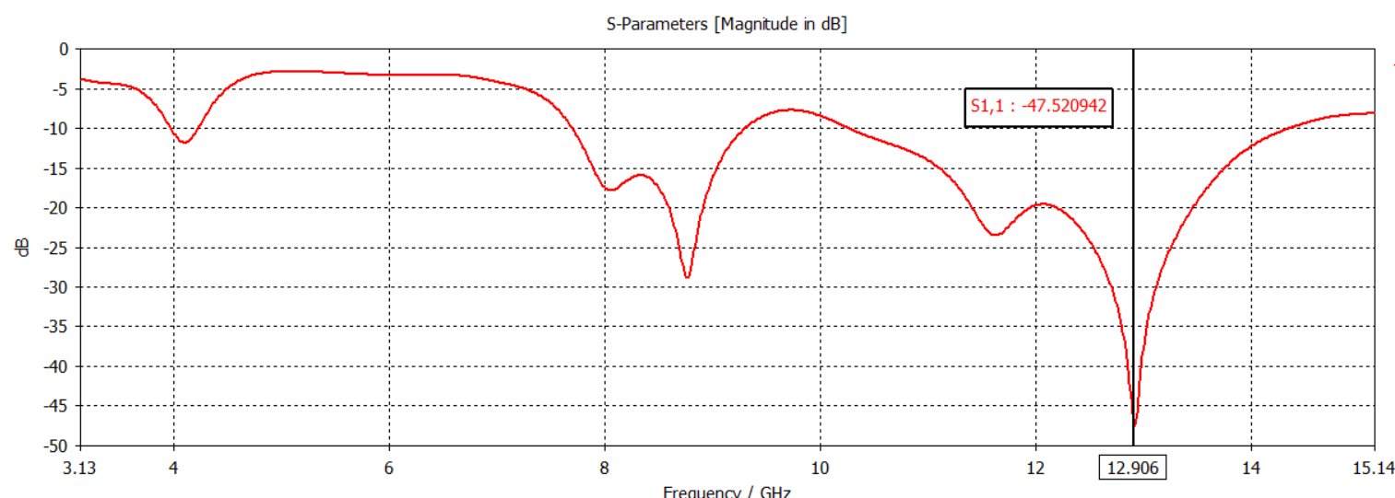
Design and analysis of a Slotted Vivaldi Antenna for Microwave Imaging Applications
2023-2024
Stage 4 : Simulation Results

Slide 37
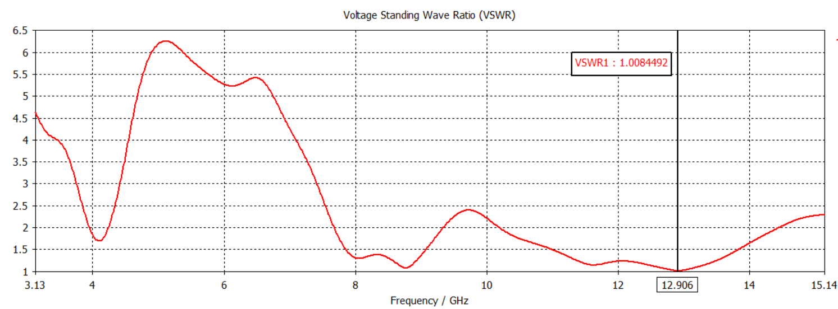
Design and analysis of a Slotted Vivaldi Antenna for Microwave Imaging Applications
2023-2024
Stage 4 : Simulation Results

Slide 38
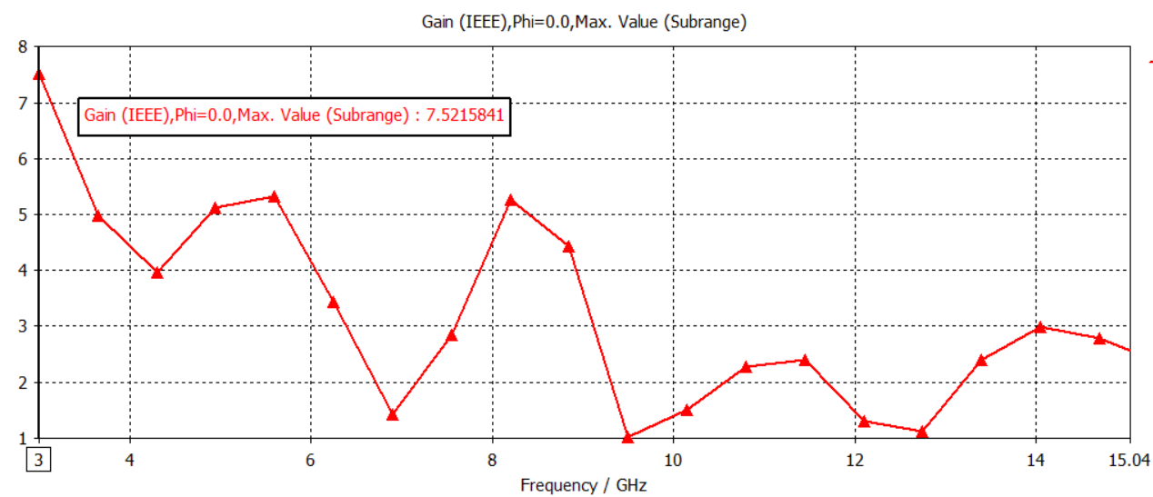
Design and analysis of a Slotted Vivaldi Antenna for Microwave Imaging Applications
2023-2024
Stage 4 : Simulation Results

Slide 39
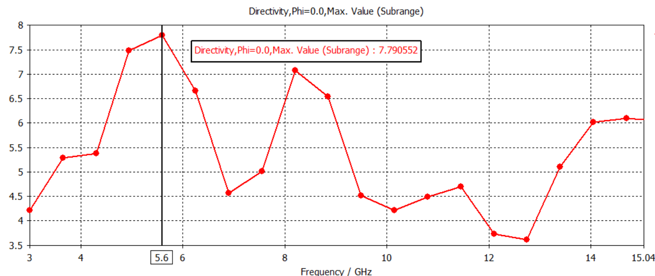
Design and analysis of a Slotted Vivaldi Antenna for Microwave Imaging Applications
2023-2024
Stage 4 : Simulation Results

Slide 40
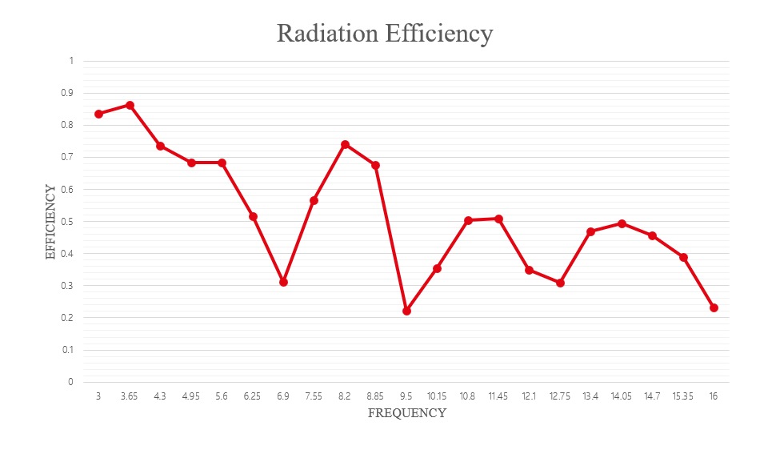
Design and analysis of a Slotted Vivaldi Antenna for Microwave Imaging Applications
2023-2024
Stage 4 : Simulation Results

Slide 41
Design and analysis of a Slotted Vivaldi Antenna for Microwave Imaging Applications
2023-2024
Performances Comparison Among the Different Design Steps
Parameters Name
STAGE 1
STAGE 2
STAGE 3
STAGE 4
Operating frequency (GHz)
6.3-12.6
5.2-12.4
5.3-12.4
3.13-15.14
BW (GHz)
6.3
7.2
7.1
12.01
Reflection coefficient (dB)
-23.1
-26.9
-39.5
-47.52
VSWR
1.15
1.09
1.02
1.008
Maximum Gain (dB)
5.3
6.10
6.91
7.52
Maximum Directivity (dBi)
7.93
7.92
8.17
7.79
Maximum efficiency (%)
80.5
81.21
82.5
86.4

Slide 42
Design and analysis of a Slotted Vivaldi Antenna for Microwave Imaging Applications
2023-2024
CONCLUSION
The literature survey and methodology for the Design and Analysis of a Slotted Vivaldi Antenna for Microwave Imaging Applications have been carefully studied.
The project has progressed through multiple design stages, successfully analyzing and optimizing a Vivaldi Antenna for microwave imaging applications.
The designed antenna exhibits a significantly broader bandwidth across all stages compared to previous models. Stage 4 achieved a bandwidth of 12 GHz, exceeding the initial limitations reported in the literature.
The project achieved a steady increase in maximum gain across all stages. The final stage boasts a maximum gain of 7.52 dB, a substantial improvement over previous low-gain limitations.

Slide 43
Project analysis slide 3
Design and analysis of a Slotted Vivaldi Antenna for Microwave Imaging Applications
2023-2024
REFERENCE
Norhayati Hamzah, Kama Azura Othman, “Designing Vivaldi Antenna with Various Sizes using CST Software” Proceedings of the World Congress on Engineering 2011 Vol II.
A. T. Mobashsher, et al., “Performance of directional and omnidirectional antennas in wideband head imaging.” IEEE Antennas and Wireless Propagation Letters 15 (2016): 1618-1621.
Md Masud Rana, Reshma Khanom and Md Mostafizur Rahman, “Design and Analysis of Vivaldi Antennas” in 2018.
N. S. B. Hasim, et al., “A slotted UWB antipodal Vivaldi antenna for microwave imaging applications.” Progress In Electromagnetics Research M 80 (2019).

Slide 44
Project analysis slide 3
Design and analysis of a Slotted Vivaldi Antenna for Microwave Imaging Applications
2023-2024
REFERENCE
C. Tian, et al., “A design of miniaturized Vivaldi antenna for UWB applications.” In 2019 International Symposium on Antennas and Propagation (ISAP), pp. 1-3. IEEE, 2019.
E. R. Alagee, Eng Reem, et al., “Brain cancer detection using U-shaped slot VIVALDI antenna and confocal radar based microwave imaging algorithm.” American Academic Scientific Research Journal for Engineering, Technology, and Sciences 66, no. 1 (2020).
A. Balaji, et al., “A unique technique to improve the performance of antipodal Vivaldi antenna for microwave imaging application.” In IOP Conference Series: Materials Science and Engineering, vol. 1055, no. 1, p. 012100. IOP Publishing, 2021.
Liton Chandra Paul, Akash Majumder, Tithi Rani “Design and Analysis of a UWB Slotted Vivaldi Antenna for Microwave Imaging Applications” IEIE Transactions on Smart Processing and Computing, vol. 12, no. 4, August 2023

Slide 45
Project analysis slide 3
Design and analysis of a Slotted Vivaldi Antenna for Microwave Imaging Applications
2023-2024
REFERENCE
H. Yu, G.H. Yang, Q. Wu and M.H. Su,“Design and Optimization of UWB Vivaldi Antenna for Brain Tumor Detection,” IEEE International Conference on Microwave and Millimeter Wave Technology (ICMMT), pp.1-3, 5-8 June 2016.
M.A. Alzabidi, M. A. Aldhaeebi and I. Elshafiey,“Optimization of UWB Vivaldi Antenna for Tumor Detection,” IEEE 1st International Conference, Modelling and Simulation, pp.71-76, 3-5 Dec. 2013.
P. Fei, Y. C. Jiao, Y. Ding and F. S. Zhang, “A compact coplanar waveguide fed wide tapered slot ultra-wideband antenna”, Progress In Electromagnetics Research Letters, Vol. 25, pp.77–85, 2011.

Slide 46
Project analysis slide 3
Design and analysis of a Slotted Vivaldi Antenna for Microwave Imaging Applications
2023-2024
REFERENCE
Victor Naydenko, Maxim Kozachuk, “Vivaldi Coplanar-Antipodal Antennas”. 2020 IEEE Ukrainian Microwave Week Kharkiv, Ukraine, September 21 – 25 2020 IEEE.
Maalik, S., “Antenna design for UWB radar detection application,” Antenna, 2010.
Baso Maruddani, Efri Sandi, and Md Fadhil Naufal Salam, (2019), “Design and Implementation of Low-cost Wideband Vivaldi Antenna for Ground Penetrating Radar” in 3rd UNJ International Conference on Technical, pages 498–506. DOI 10.18502/kss.v3i12.4118.
Y. Erdogan, "Parametric Study and Design of Vivaldi Antennas and Arrays", Ankara, Turki: Middle East Technical University, 2009.

Slide 47
Thank You

